Slide 1
Computer graphics (CS 77/177) final project
11/16/2015
Srinath Ravichandran Yuan Tian

Slide 2
Implemented Concepts
Extended Ray tracing concepts.
Soft shadows – sampling area lights
Texture tiling – extending the texture coordinates beyond [0 – 1]^2
Projective texture mapping – using spherical/cylindrical mapping
Mesh intersection – using triangular meshes for object representation
Environment lighting – using textures to light a scene
Indirect illumination – global illumination by multiple bounce light

Slide 3
Soft Shadow
Num of Samples = 10
Noisy Shadow
Num of Samples = 50
less Noisy
Num of Samples = 500
Smooth Soft Shadow
Num of Samples = 50

Slide 4
Texture Tiling
Tiling Range = 10 * 10
Tiling Range = 4.3 * 4.3
Tiling Range = 5.7 * 5.7
Challenges : Making sure tiling worked for arbitrary sized texture coordinates in addition to rounded coordinates.

Slide 5
Projective Texture Mapping
Challenges : Figuring out how to correctly warp the texture around the sphere. Used a calibration texture to
understand how the ‘uv’ parameters varied across the surface.

Slide 6
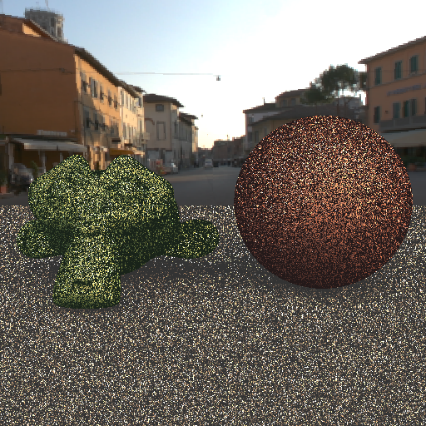
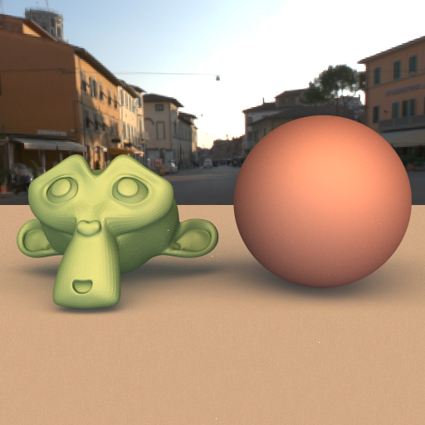
Environment lighting
1 sample per pixel
128 samples per pixel

Slide 7
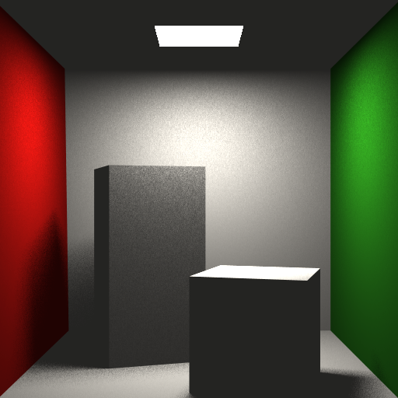
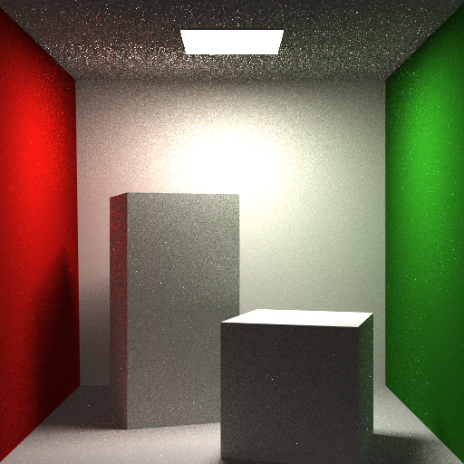
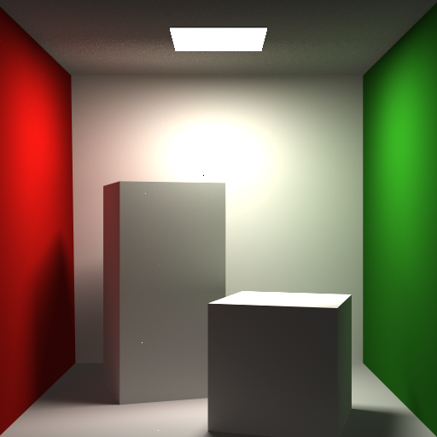
Indirect Illumination
Direct lighting only
Multiple bounces - Noisy
Multiple bounces – More samples
aka less noisy.
Challenges : 1. Making sure no double contributions are computed.
2. Correct Accumulation terms and probability terms
3. Rendering optimizations – traverse only on valid computations.

